Slide 1
FAIR USE NOTICE
The material used in this presentation i.e., pictures/graphs/text, etc. is solely intended for educational/teaching purpose, offered free of cost to the students for use under special circumstances of Online Education due to COVID-19 Lockdown situation and may include copyrighted material - the use of which may not have been specifically authorised by Copyright Owners. Its application constitutes Fair Use of any such copyrighted material as provided in globally accepted law of many countries. The contents of presentations are intended only for the attendees of the class being conducted by the presenter.

Slide 2
TEMPORAL LOGIC
REFINEMENT, CONCURRENCY & COMMUNICATION

Slide 3
Contents
Refining Temporal Specifications
Specification of concurrent behavior
Specification for communication between concurrent components

Slide 4
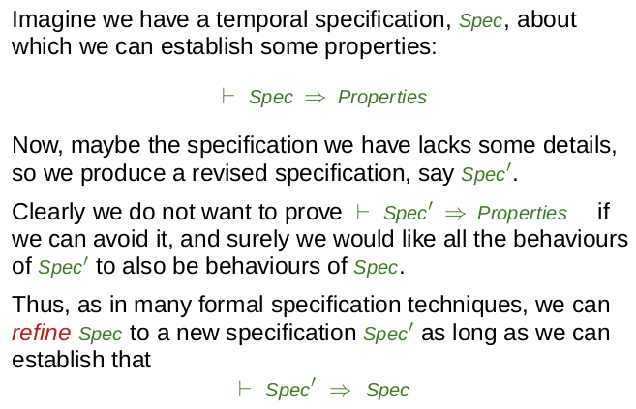
Refinement

Slide 5
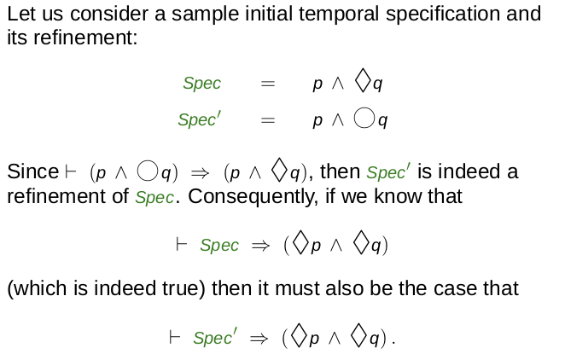
Example

Slide 6
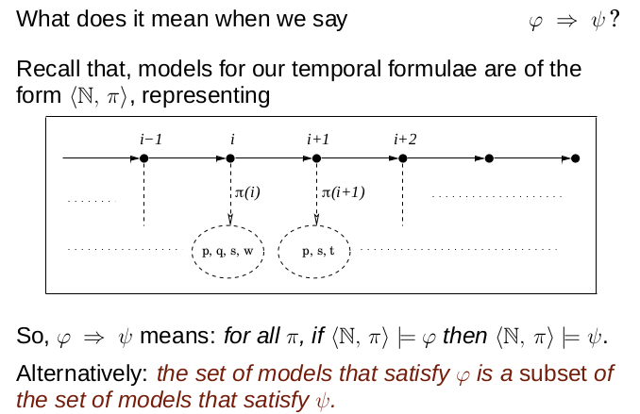
The meaning of ‘⇒’

Slide 7
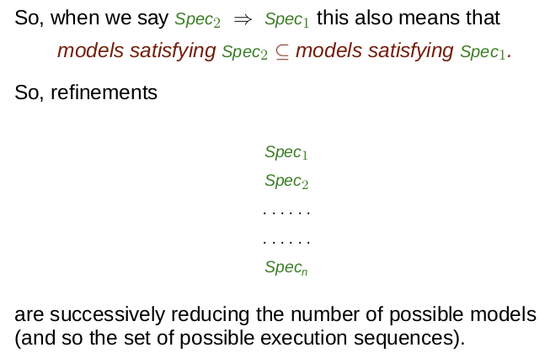
Refinement Contd.

Slide 8
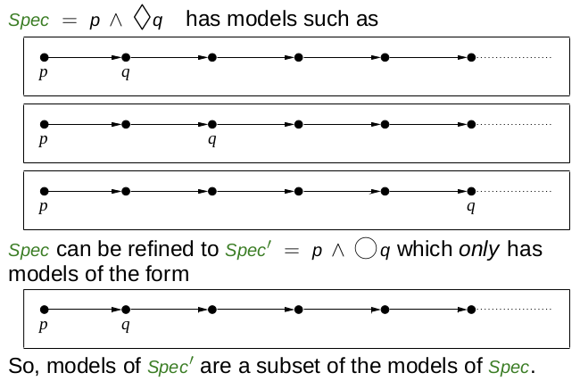
Example

Slide 9
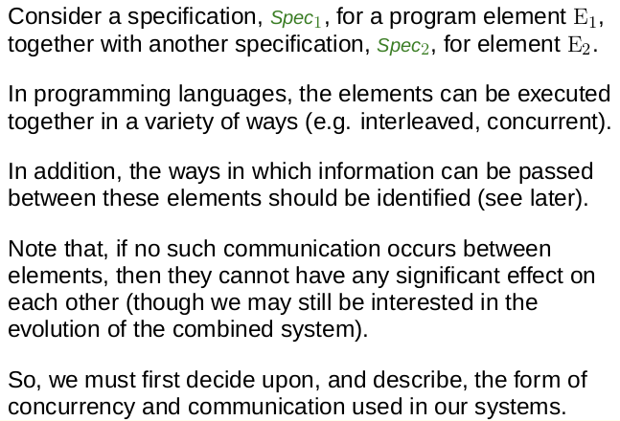
Linking Specification

Slide 11
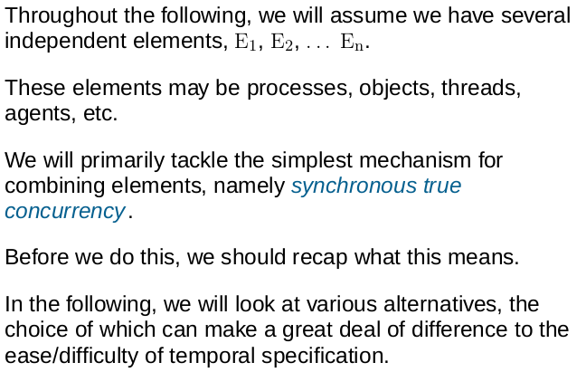
Concurrency

Slide 12
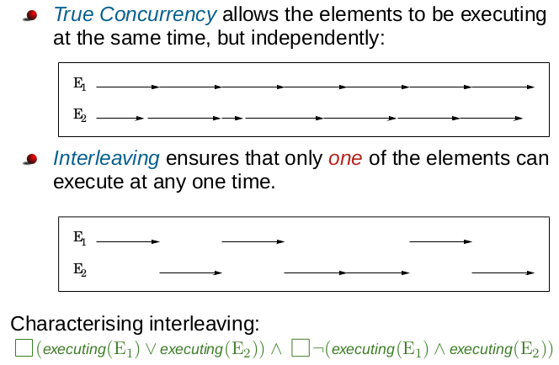
Interleaving vs True Concurrency

Slide 13
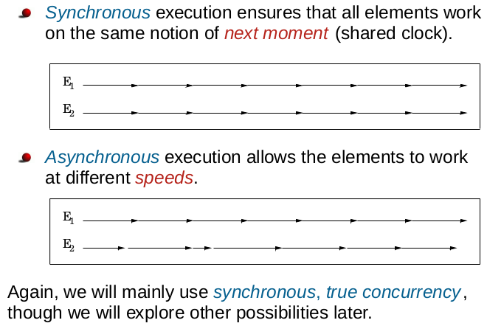
Synchrony vs Asynchrony

Slide 14
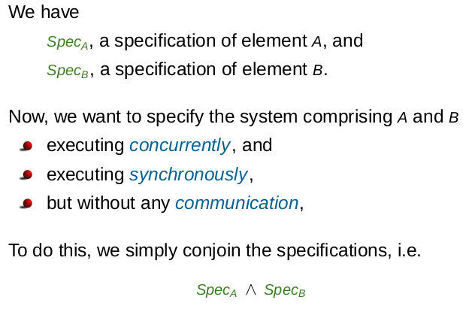
Concurrency

Slide 15
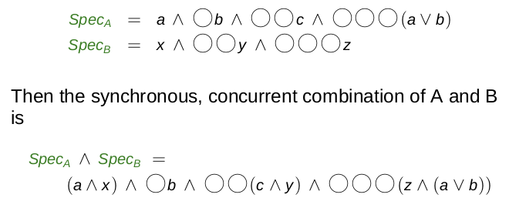
Example

Slide 16
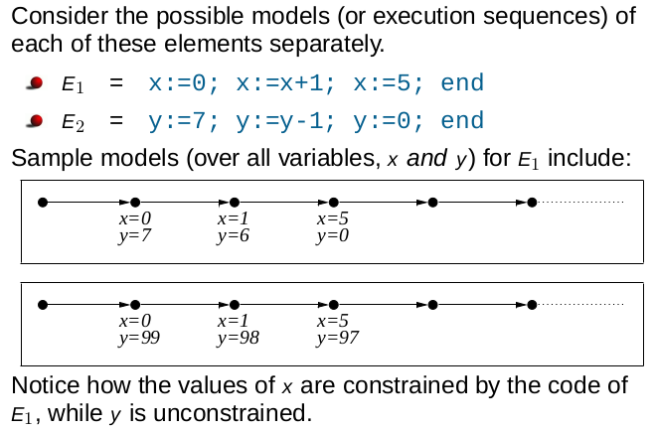
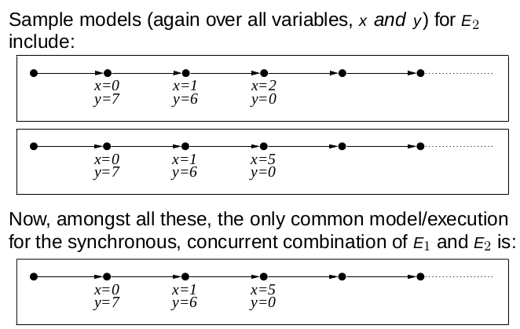
Example
Spec_{E1} = O(x=0) ^ OO(x=1) ^ OOO(x=5)
Spec_{E2} = O(y=7) ^ OO(y=6) ^ OOO(y=0)
Spec_{E1} ^ Spec_{E2} = O((x=0)^(y=7)) ^ OO((x=1)^(y=6)) ^ OOO((x=5)^(y=0))

Slide 17
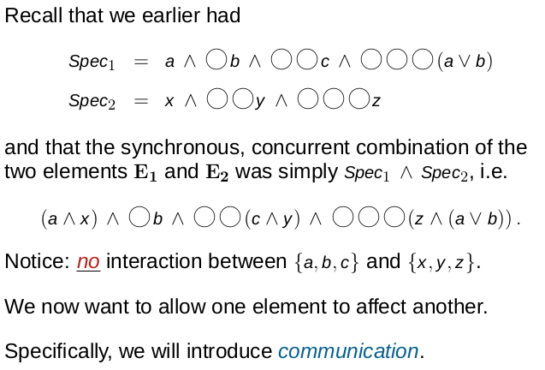
Communication

Slide 18
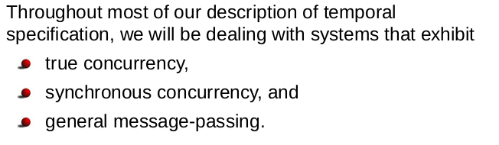
Our Assumptions

Slide 19
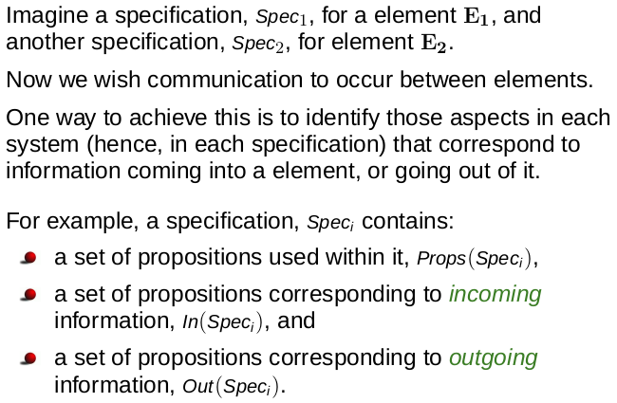
Linking Specifications

Slide 20
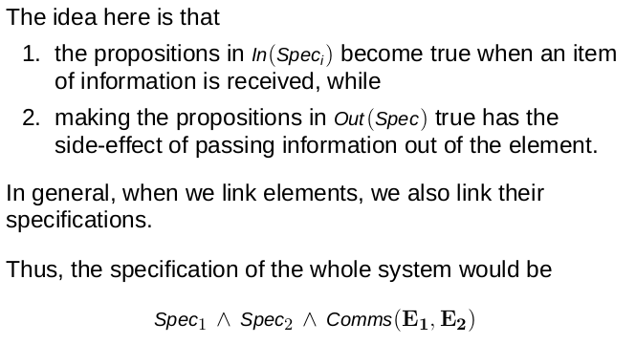
Linking Specifications

Slide 21
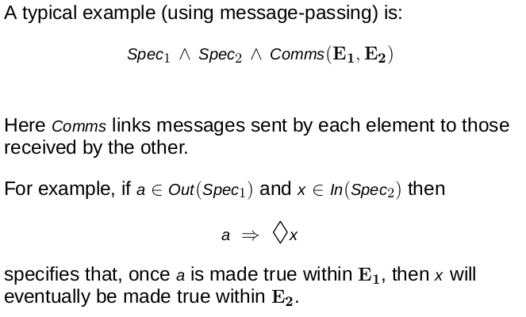
Linking Specifications

Slide 22
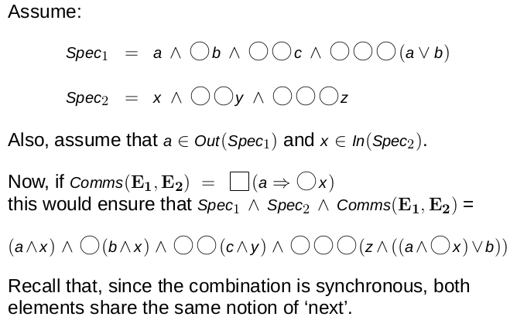
Example 1

Slide 23
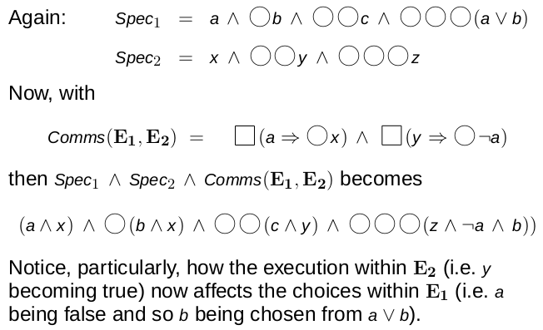
Example 2

Slide 24
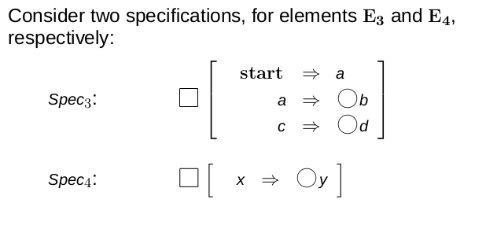
Example 3

Slide 25
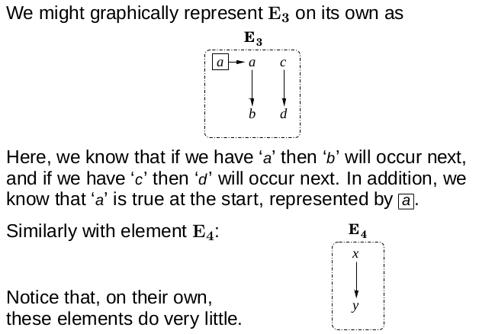
Graphical Representation

Slide 26
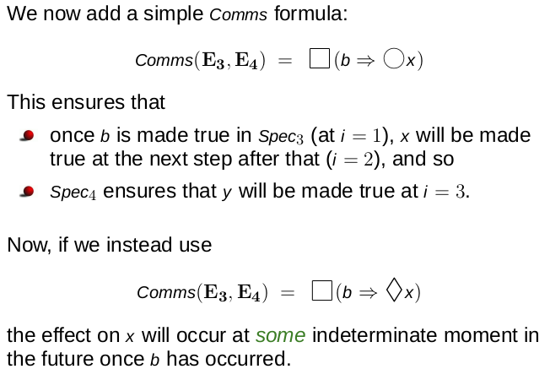
Adding Comms (E3, E4)= □(b ⇒ Ox)

Slide 27
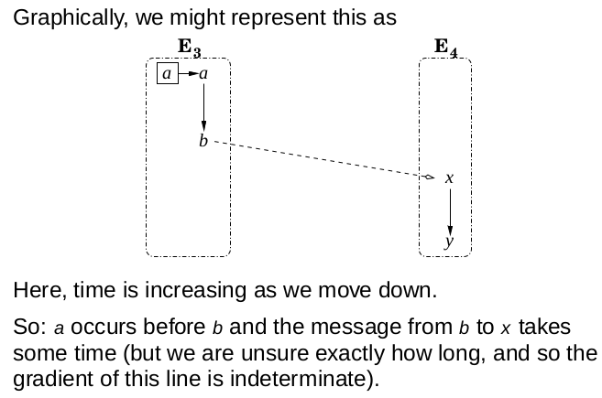
Adding Comms (E3, E4) = □(b ⇒♢x)

Slide 28
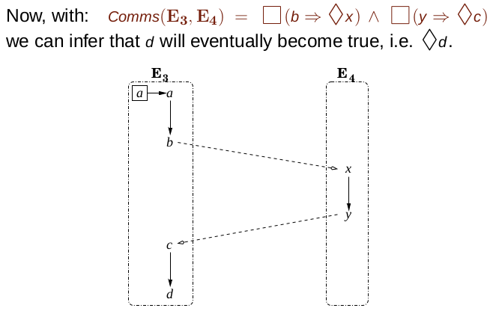
Adding Comms(E3, E4)=□(b⇒♢x)∧□(y⇒♢c)

Slide 29
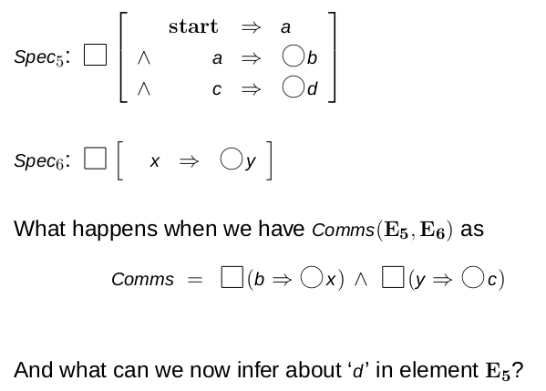
Exercise

Slide 30
Thank You!

